Slide 1


Twitter Search Application
Special Topics – Database Management Systems for Advanced Applications
Team
Nikitha Sunku Prashanth - ns1590
Priyanka Nagasuri - pn296
Nancy Soni - ns1583
Shruthi Nanditha Ganesh - sg2057

Slide 2


Architecture
UI: Jupyter Notebook
Query
File
Search Application
Cache
Python Dictionary
User
Tweet
PostgreSQL data store
MongoDB data store

Slide 3
Create a table ”twitter_users_partitioned”
Create an index on ‘name’ and compound index on "followers_count“ & "verified"
The insert_user_info function is designed to insert data into the twitter_users_partitioned table
Load each record at a time
If existing user, we skip the record
Installed Postgres and establish a connection
Relational Datastore - PostgreSQL

Slide 4

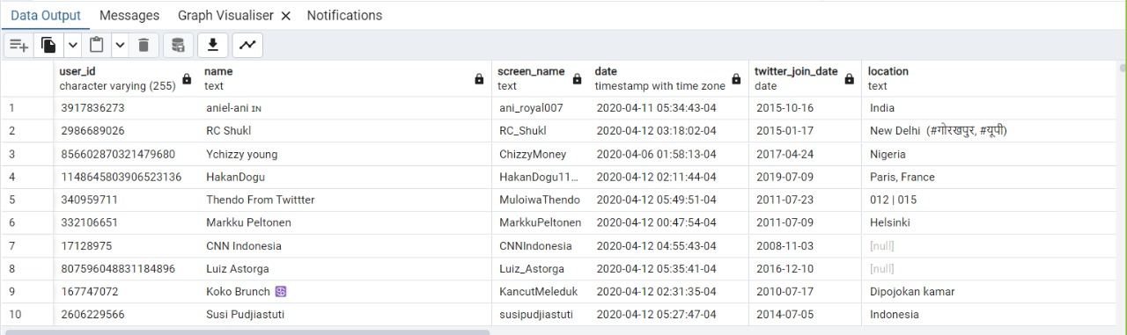
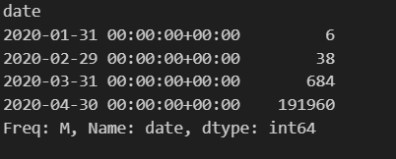
Data Analysis and reporting
Columns Retained in the Database
user_id: The unique identifier for the user.
name: The user's name.
screen_name: The user's Twitter handle.
date: The date associated with the user data (might be extracted from the tweet data).
twitter_join_date: When the user joined Twitter.
location: The user's location as stated in their profile.
description: The user's profile description.
verified: Boolean indicating whether the user is verified.
followers_count: Number of followers the user has.
friends_count: Number of friends (or following) the user has.
listed_count: The number of public lists that this user is a member of.
favourites_count: The number of tweets this user has liked in the account’s lifetime.
language: The language of the user as stated in the profile.

Slide 5
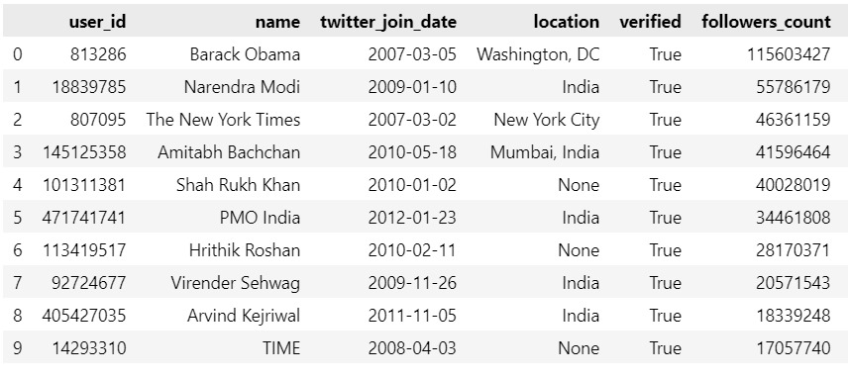
Top users with most number of followers

Slide 6
Install MongoDB and MongoDB compass
Create a connection and then a database “twitter_db”
Create a collection “tweets_data”
Create index on name, date, text and hashtags in MongoDB
Extract required fields
Load tweet data and retweet data
Index on hashtags, usernames, tweet text, tweet date
Clean created_at date column to twitter_join_date
Non-Relational Datastore - MongoDB

Slide 7
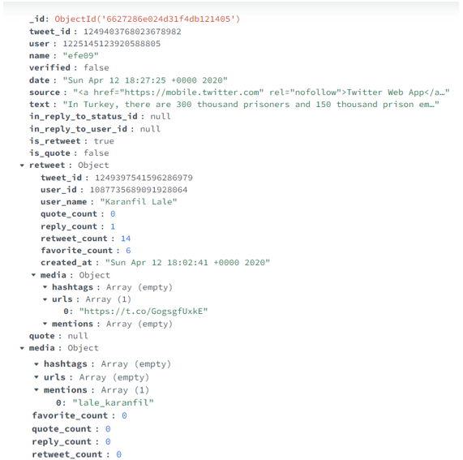
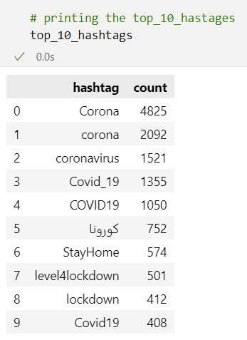
Tweet schema in MongoDB
Top hashtags

Slide 8
Caching
Used a Python dictionary for caching
Limited the length of the cache to 100 records
Evicting strategy
Least Recently Used (LRU)
Pop earliest accessed
Time-To-Live field
Write the cache to disk for every 3600 seconds

Slide 9
Cache Performance
Query | Without Cache (in secs) | With Cache (in secs)
Top 10 Popular Users | 2.7045 | 0.0011
Hashtag Search | 1.2304 | 0.0015
Top 10 Popular Hashtags | 0.2067 | 0.0032
User search | 0.5251 | 0.0032
Word search | 2.6057 | 0.0011

Slide 10
Workflow of Searching a Query
Check Python dictionary (cache) if it is present
If No, get the user data from disk
(PostgreSQL)
If Yes, get the tweet data from python dictionary
If No, get the tweets data from disk
(MongoDB)
Display results and add query to cache
Update the Cache

Slide 11
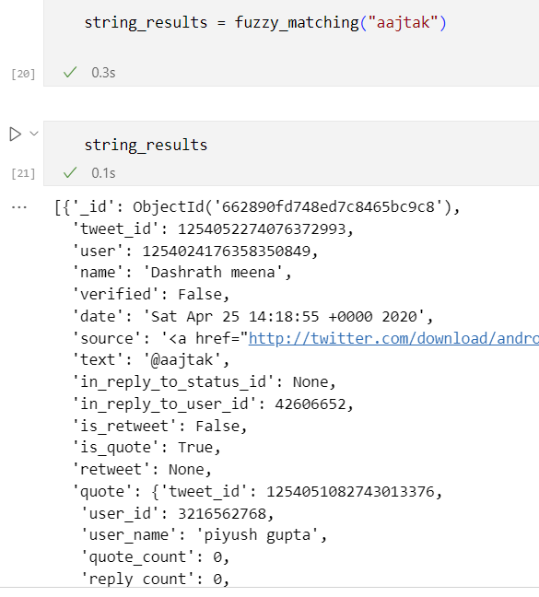

Search by String

Slide 12
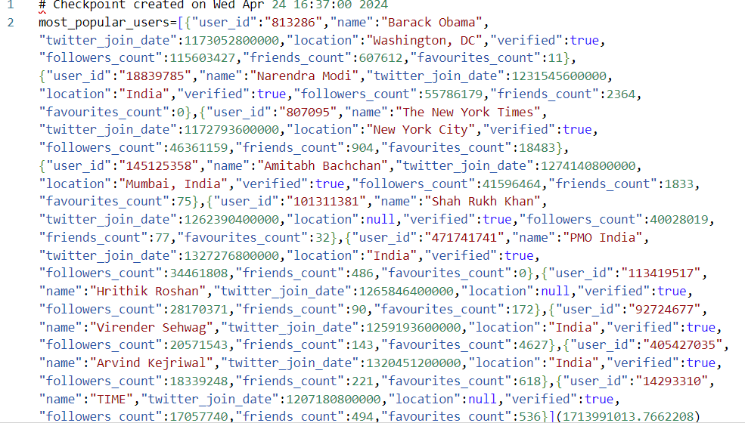







Most popular users

Slide 13
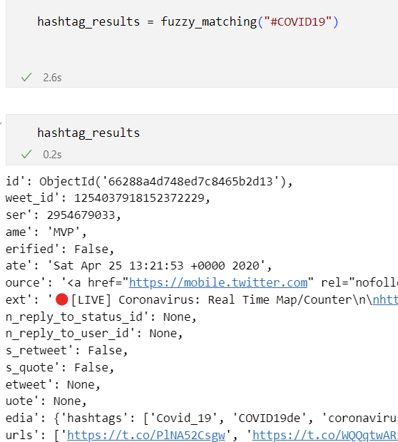
Search by Hashtag

Slide 14
Data Summary
Metric | value
Data size | 203K
Number of Users | 88k
Time taken to load the data | 50 min
Most popular User | Barack Obama
Most Popular Hashtag | Corona

Slide 15
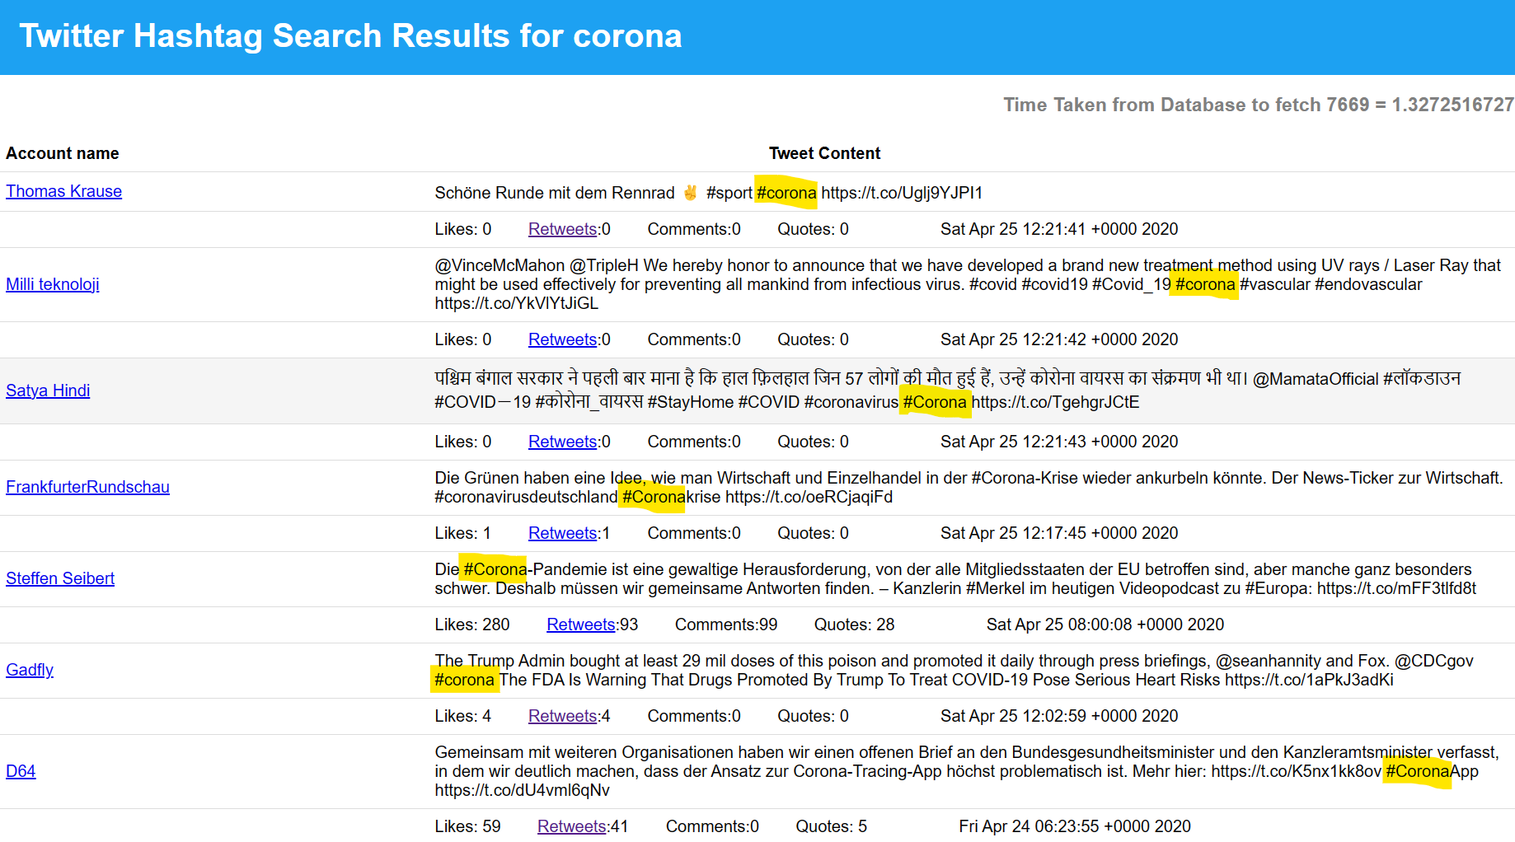
Searching Application

